Slide 1
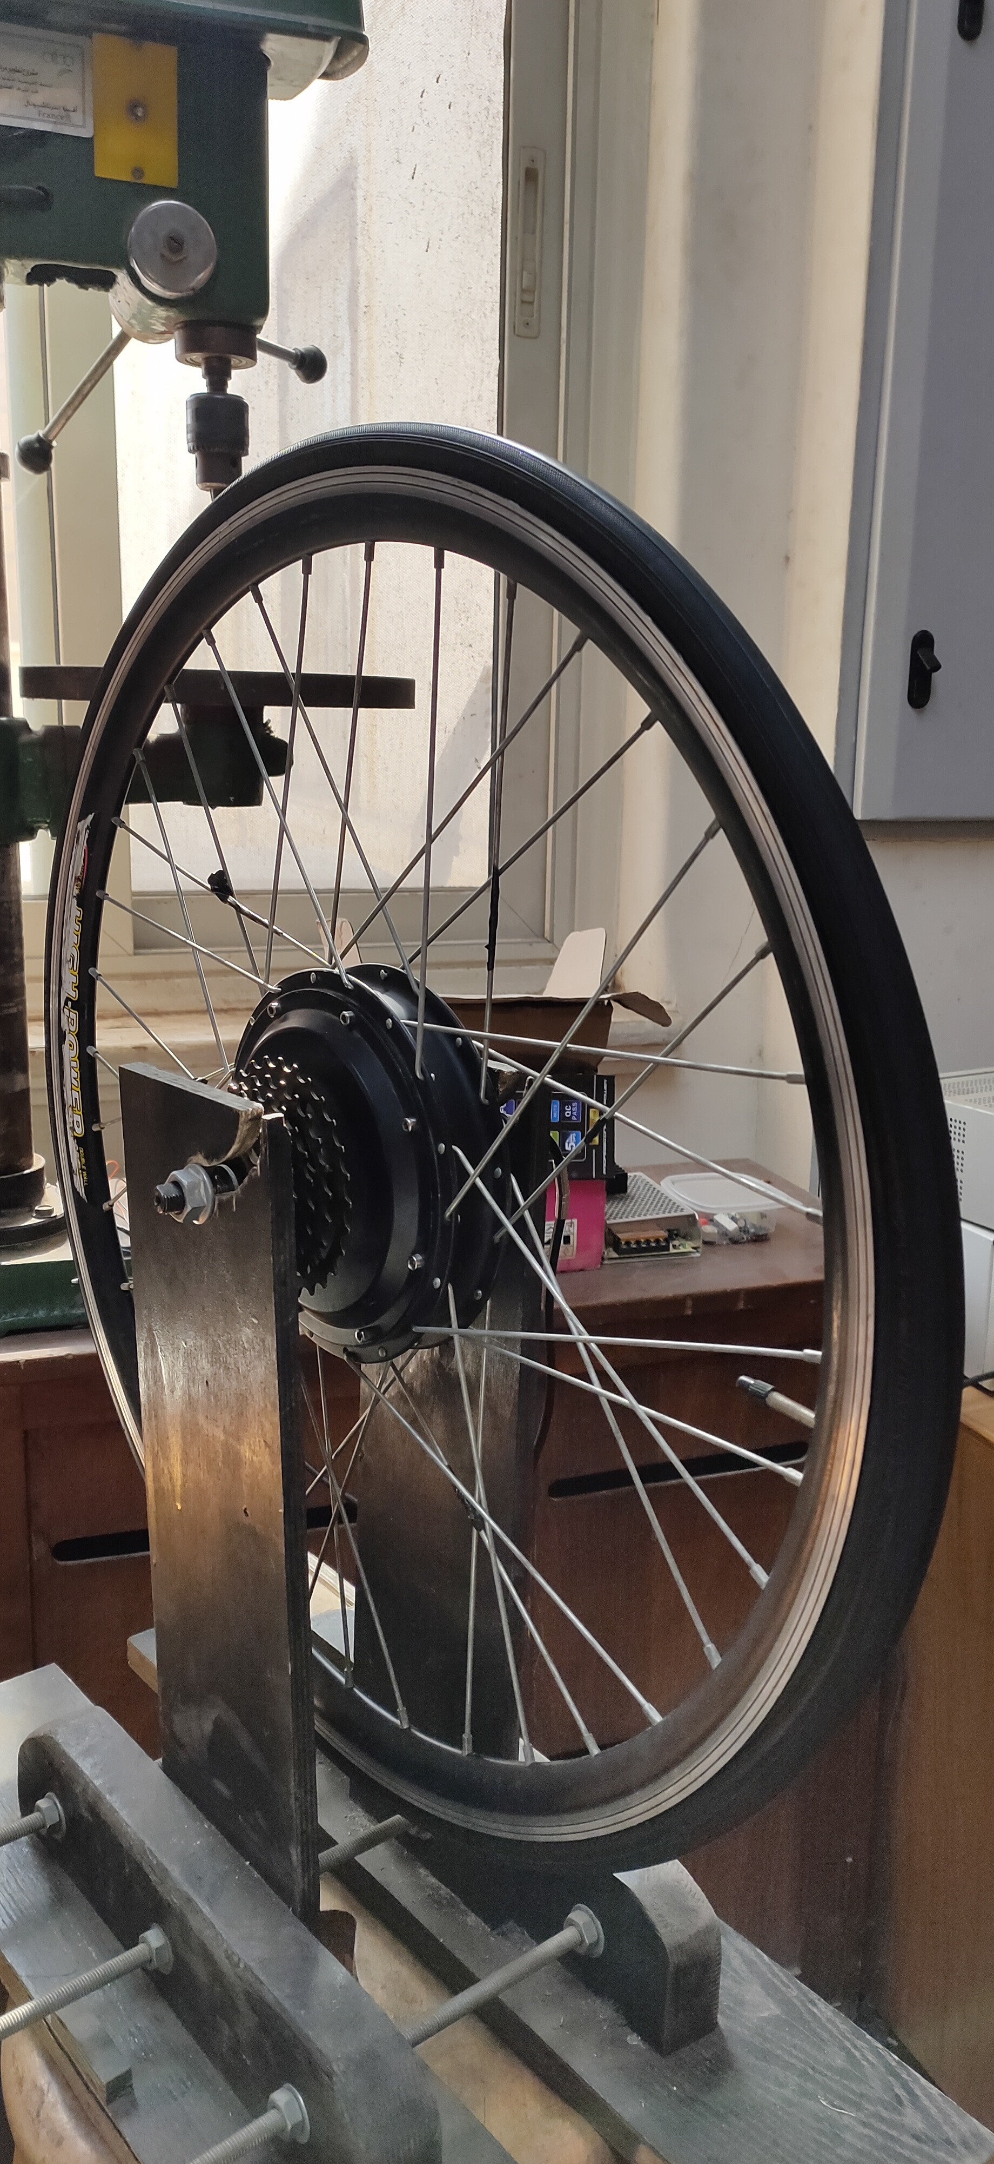

Prototype Electric Vehicle
Presented to
Dr. Ahmed Lotfy

Slide 2







Team Members
Abd-Elrahman
Ali
Emad
Awab
Mohamed
Ragab
Ezz-Eldien
Magdi
Ehab
Ashraf

Slide 3

Agenda Items
Project Objective
Progress overview (H/S)
Introduction
BLDC Motor
Hardware Design
Hardware Testing
Open loop system
Closed loop system
Timeline

Slide 4
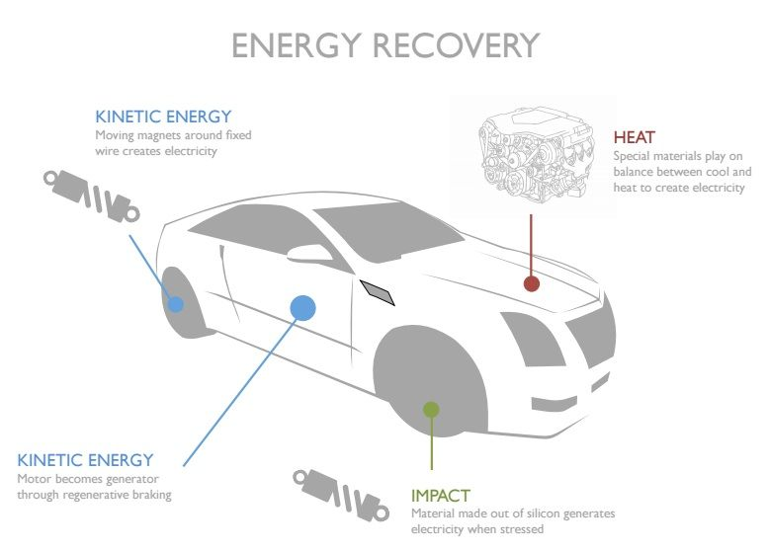
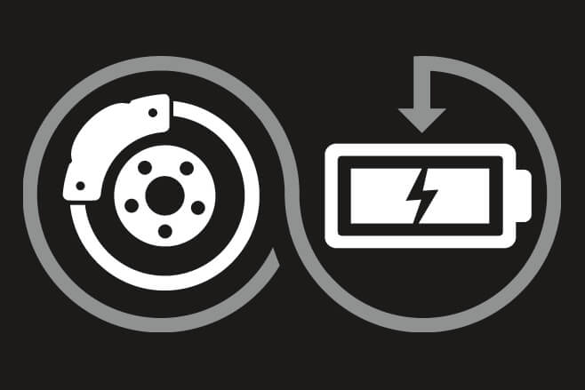
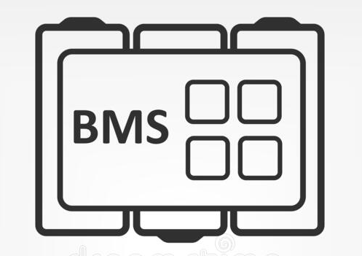
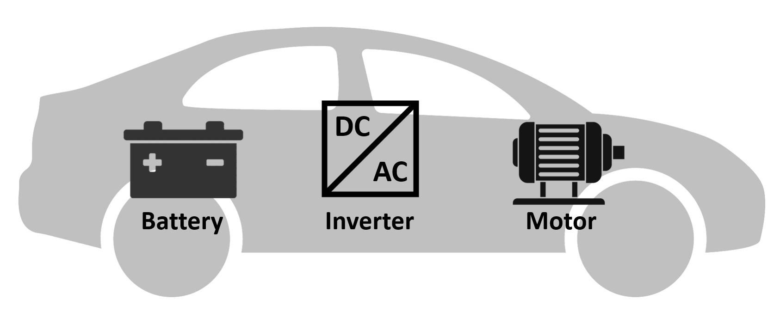
Project Objective
Building BLDC Inverter from scratch
Improving system efficiency
Perform regenerative
breaking
Design and implement BMS

Slide 5


Our Progress
This will be achieved by:
Hardware
Software

Slide 6
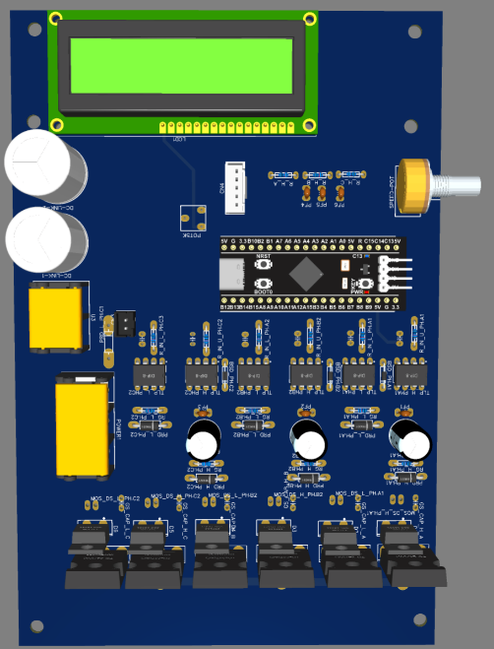
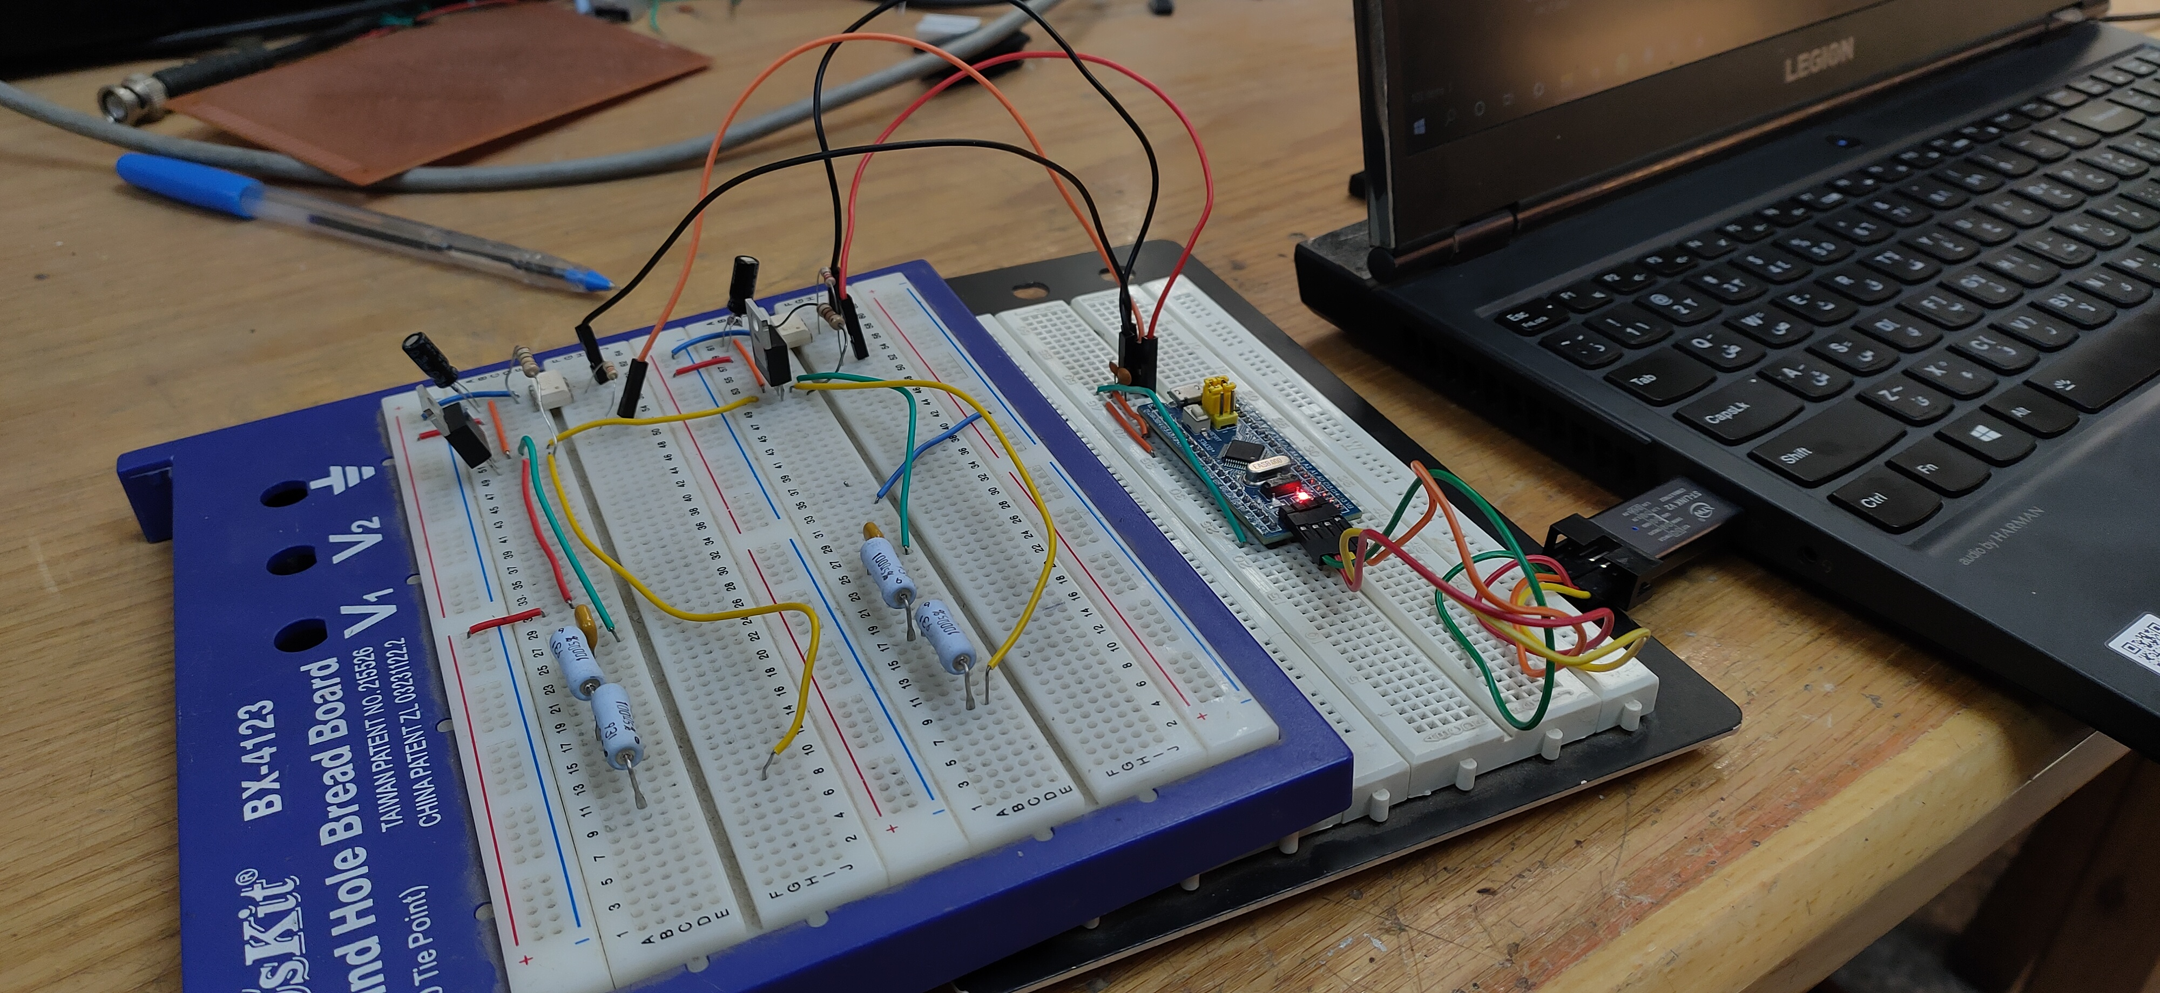
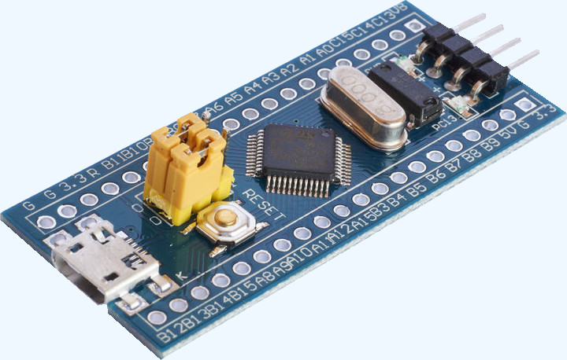
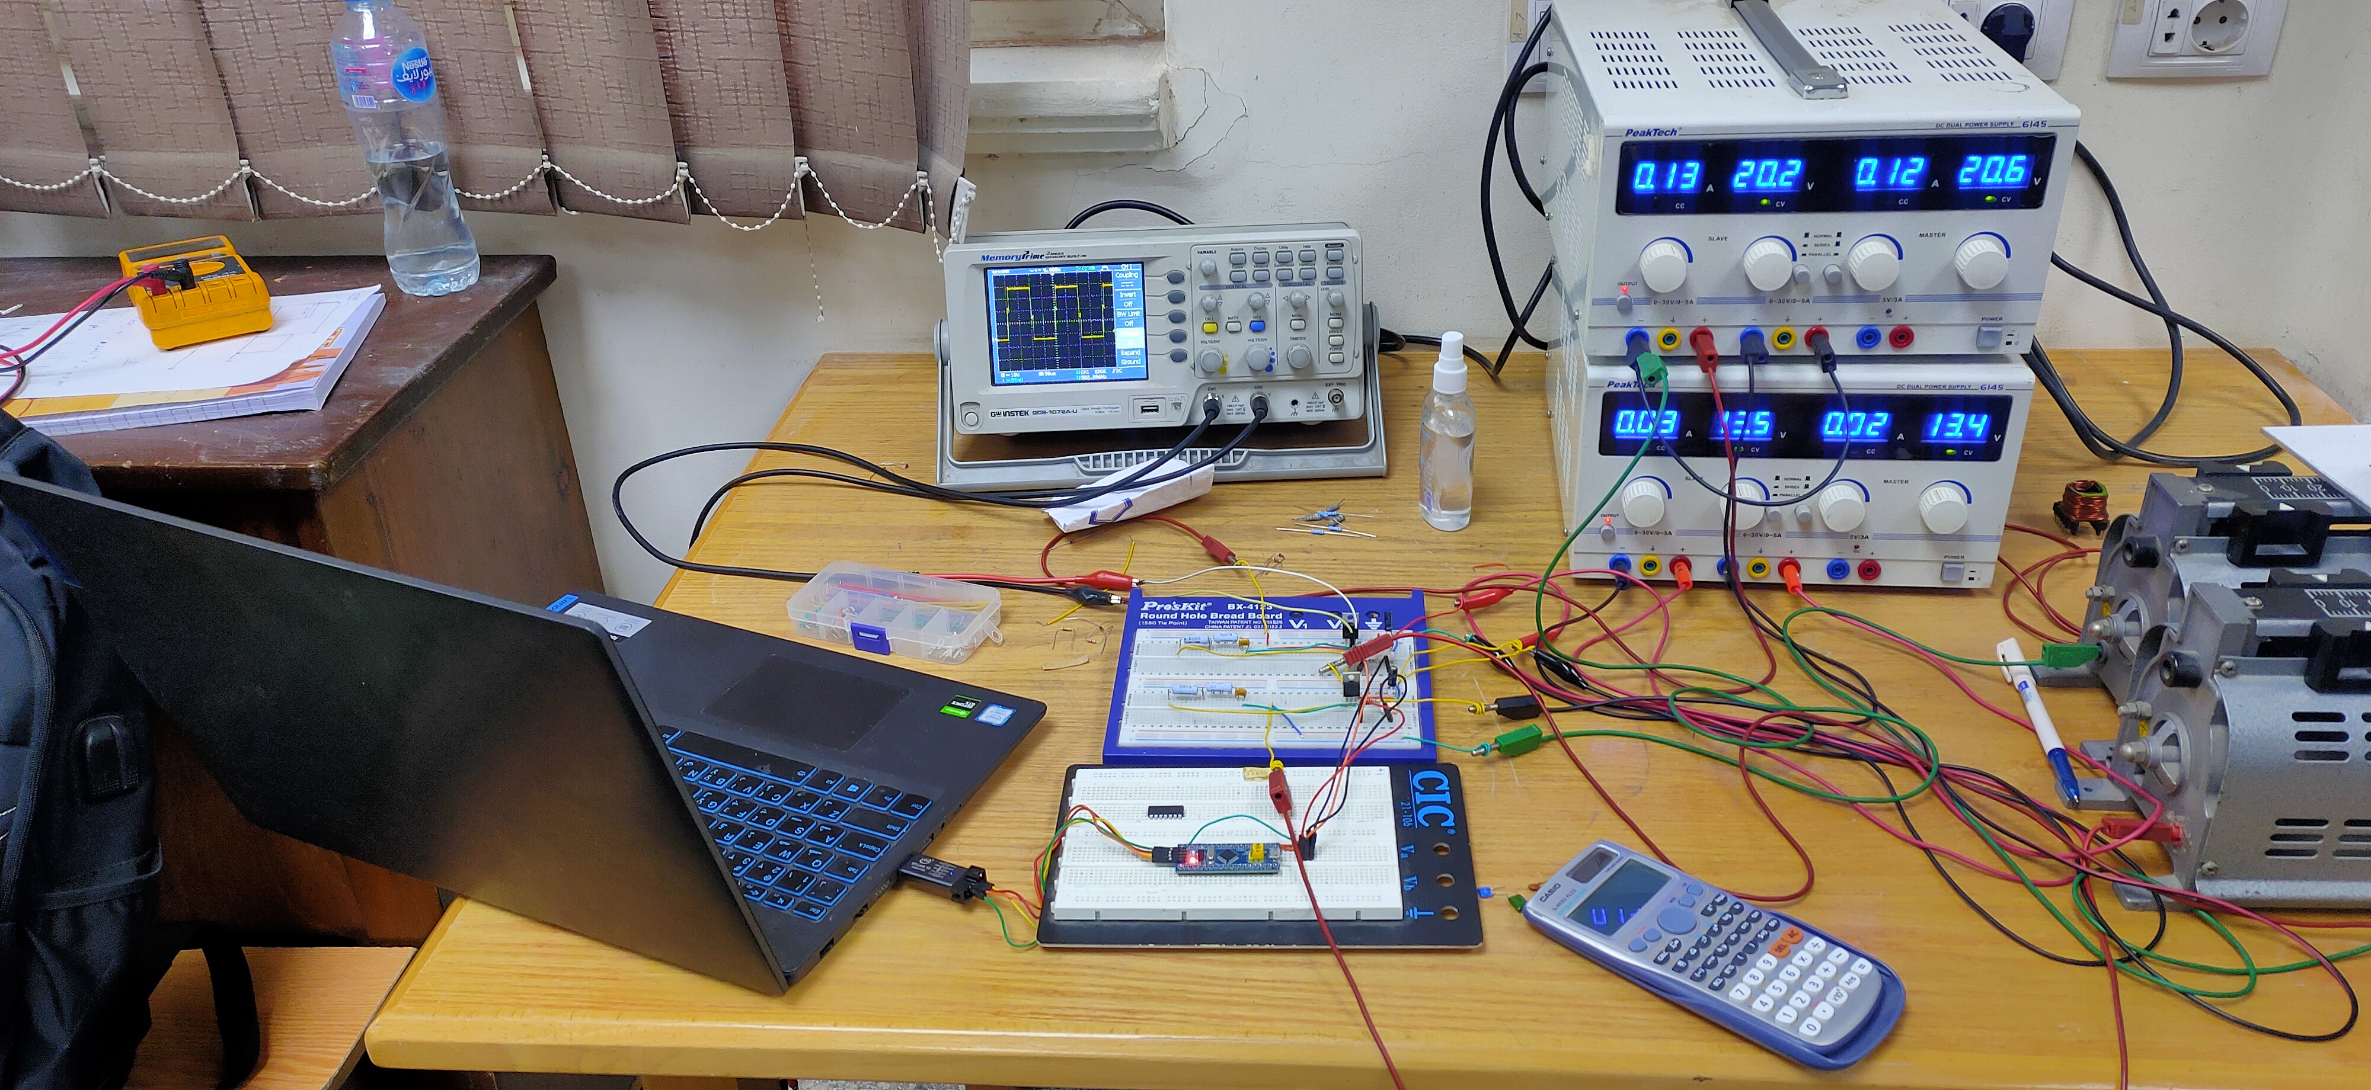
Hardware
To There
(3phase open loop inverter)
From Here (one Leg)

Slide 7
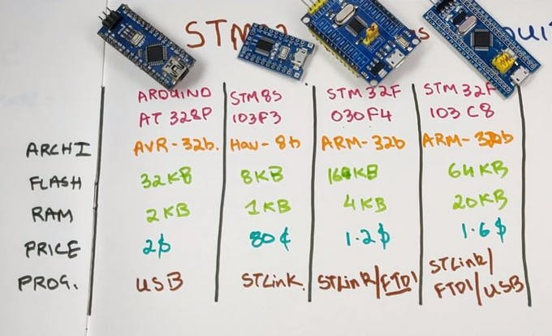
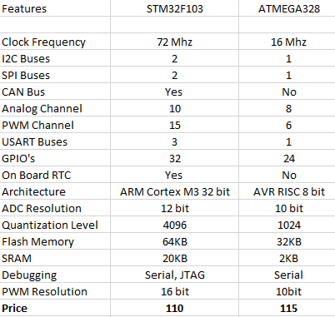
STM32 specs.

Slide 8

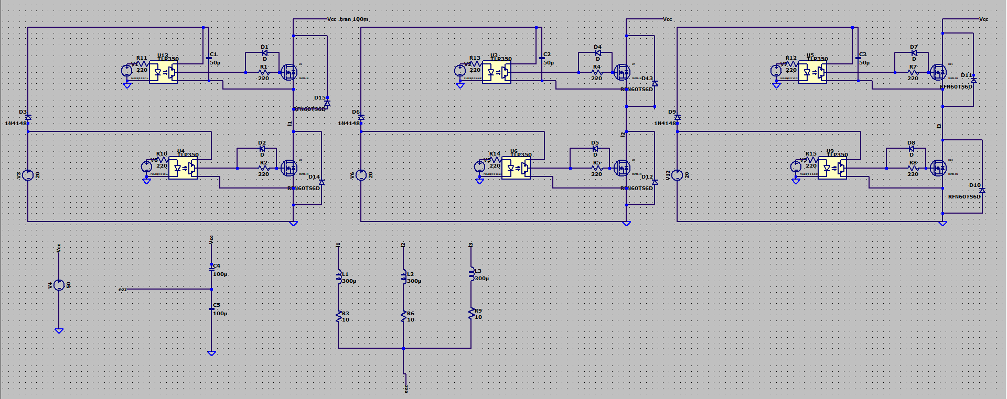
Software
(three phase inverter)

Slide 9
Introduction
Why Brushless Motor ?
DC Motor
Pros
High starting torque
Low cost
Suited to Industrial Environment
Cons
High Maintenance Cost
Lower Speed
Brushless Motor
Pros
Long Lifespan
High Efficiency
Low noise and quiet operation
Cons
Require Controller
Cost Of Controller and Drivers

Slide 10
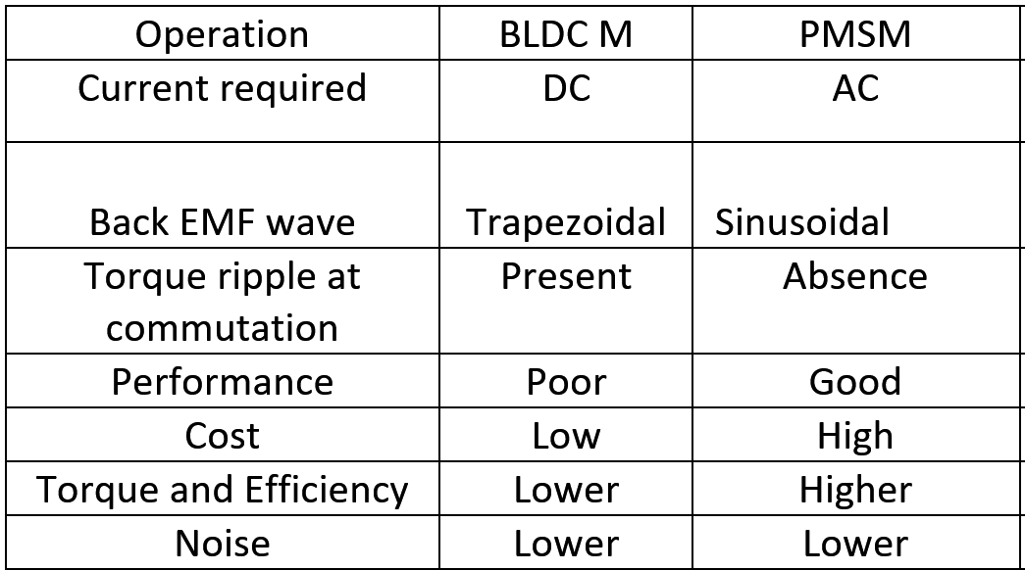
Introduction
Why BLDC ?

Slide 11
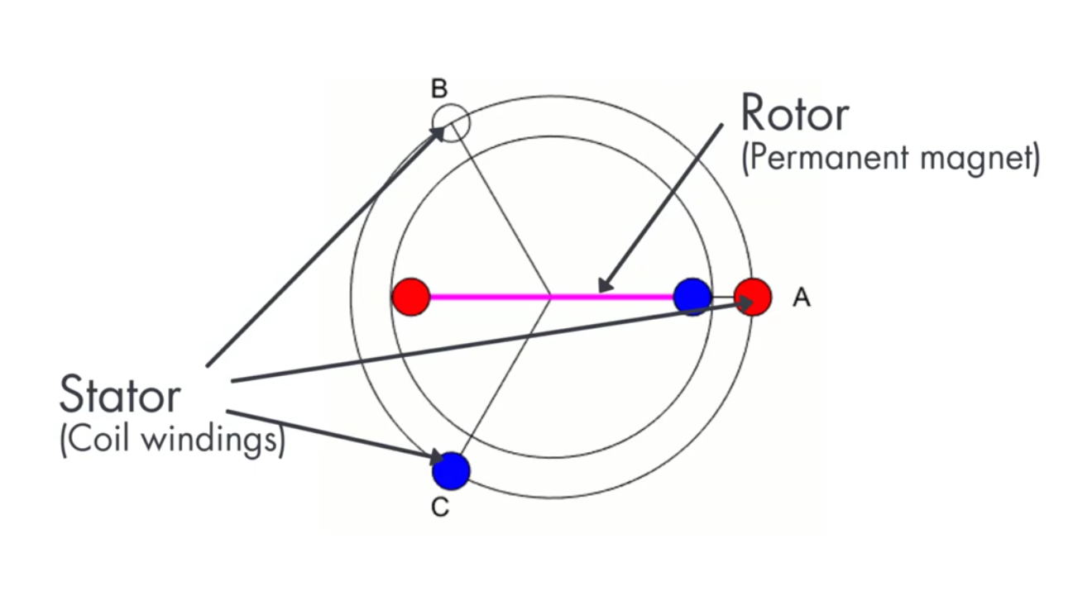
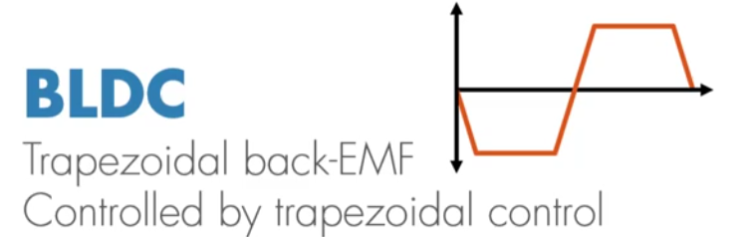
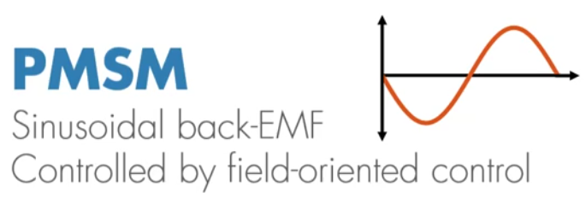
BLDC motors structure
We can consider BLDC motors as a flipped version of brushed DC motors as we have :
Permanent magnet represents the rotor
3 phase coils represents the stator
We can consider that BLDC motors and PMSM motors are synchronous motors but they have differences in EMF ch/cs which lead to different control algorithms.

Slide 12
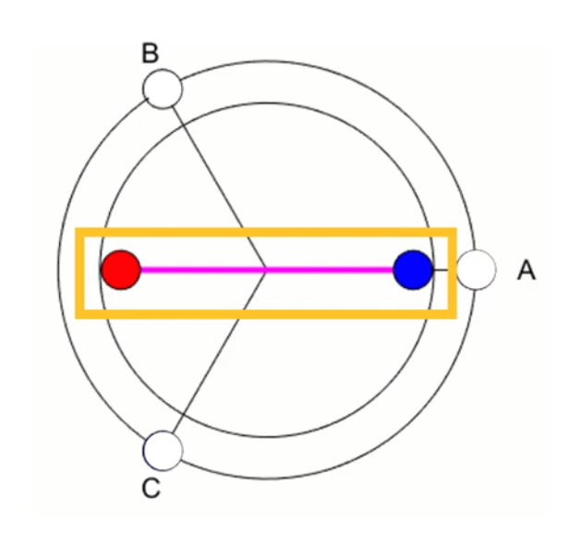
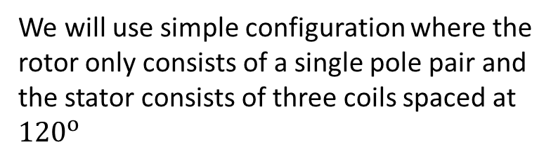
Principle of Operation
Inner working of the motor
We will use simple configuration where the rotor only consists of a single pole pair and the stator consists of three coils spaced at ${120}^{o}$
Applying voltage across two phases A and C generates a combined magnetic field along
the dashed line

Slide 13
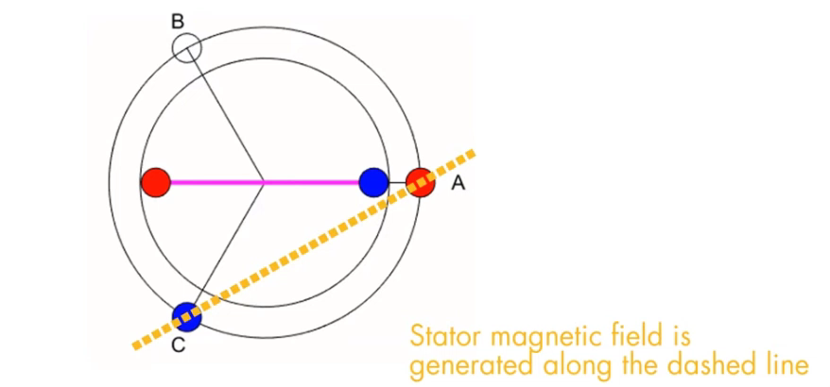

Principle of Operation
Inner working of the motor
The rotor now starts to rotate to align itself with the stator magnetic field
There are six possible ways of energizing coil pairs
What this mean if we can commutate the correct phases every ${60}^{o}$ ?
We can make the motor spin and this is called six step commutation or trapezoidal control

Slide 14
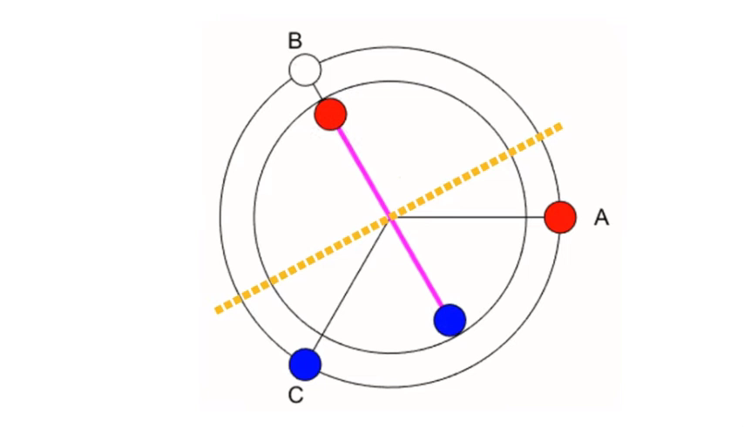
Principle of Operation
Inner working of the motor

Slide 15
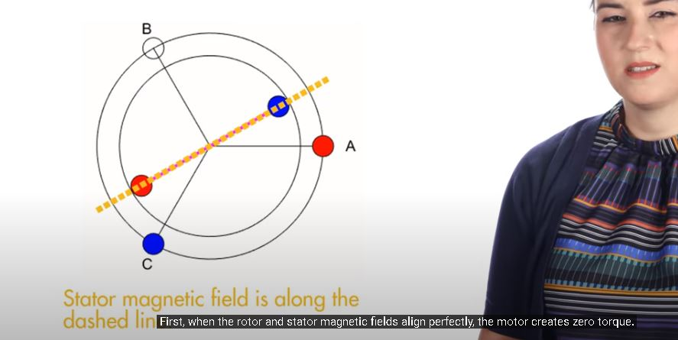
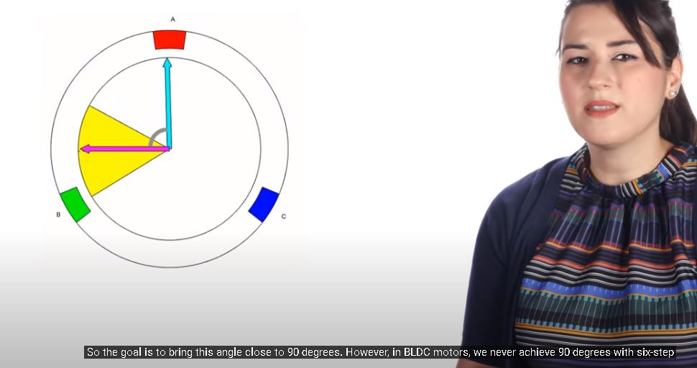

Principle of Operation
Inner working of the motor
The motor creates zero torque
Maximum torque occurs when the fields are at ${90}^{o}$to each other

Slide 16
Principle of Operation
Which and when each coil is Energized ?
IN BLDC WE USE AN ELECTRONIC CONTROLLER FOR THIS PURPOSE A SENSOR DETERMINE THE POSITION AND SPEED OF THE ROTOR AND BASED ON THIS INFORMATION THE CONTROLLER DECIDES WHICH COILS TO ENERGIZE

Slide 17
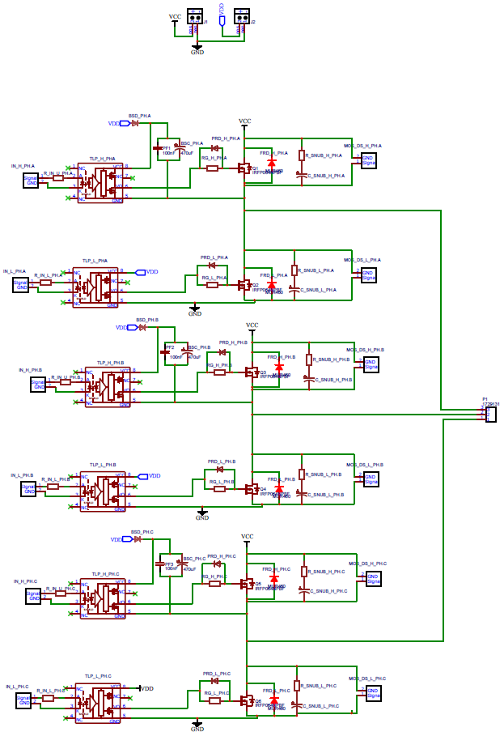
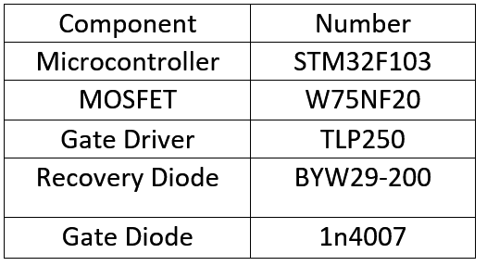
Hardware Design
Component Selection of the inverter circuit

Slide 18
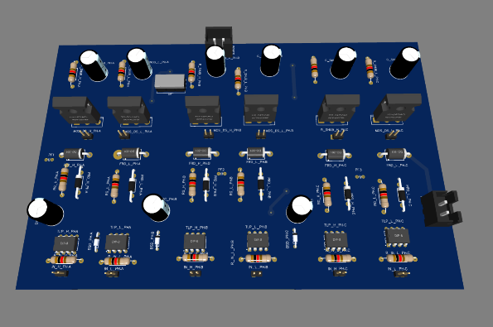
Hardware Design
PCB Design
1 – old Version
20
18

Slide 19
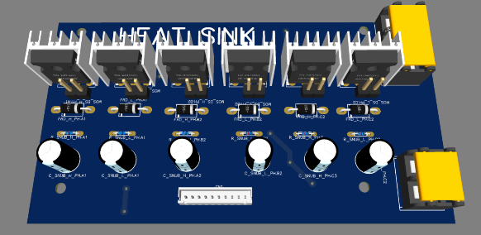
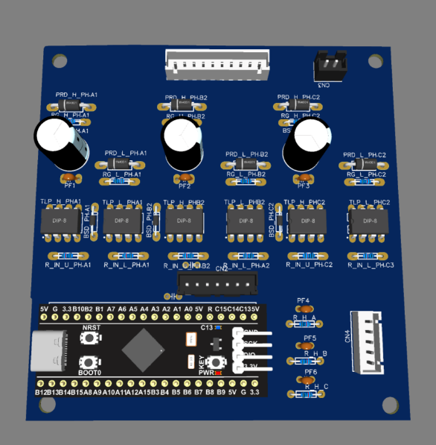
Hardware Design
PCB Design
2 – Updated Version
19
19
19

Slide 20
Hardware Design
PCB Design
3 – Current Version
20
20
20

Slide 21
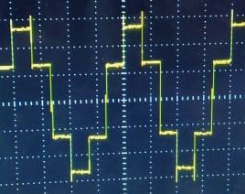
Hardware Testing
Inverter Output
Inverter circuit output line voltage with
Inductive load without Snubber Circuit
[R = 35 Ω, L = 1.5 mH].
21
21
21
21

Slide 22
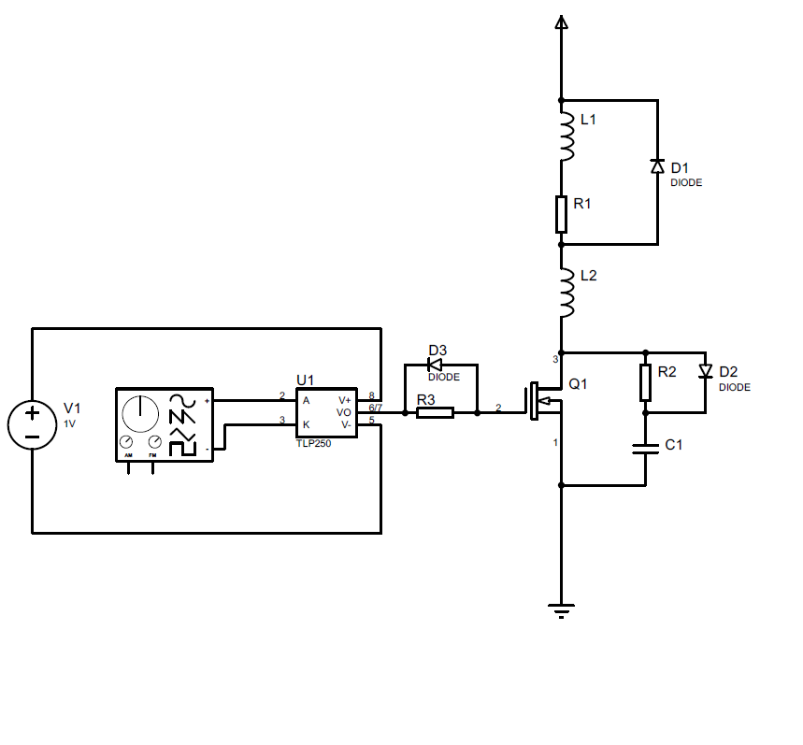
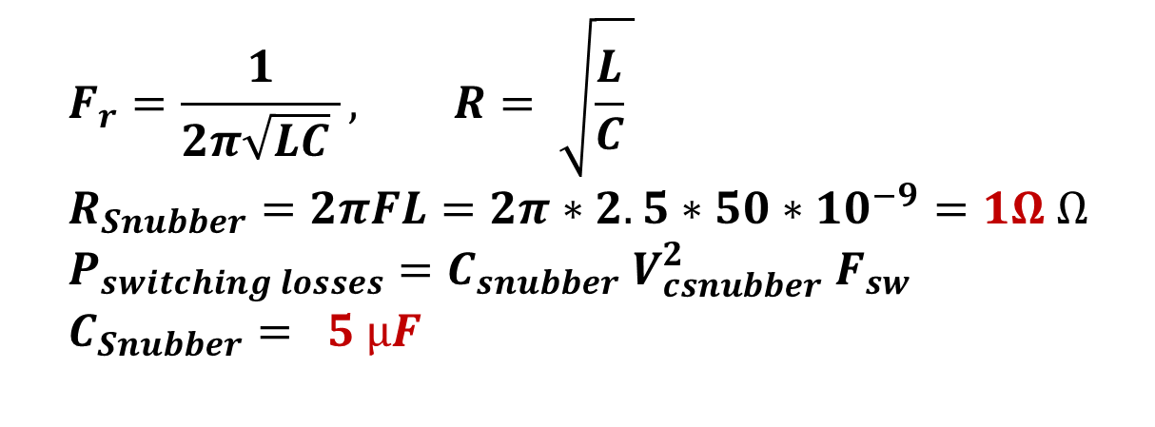
Hardware Testing
Snubber Design
$$F_{r}=\frac{1}{2π\sqrt{LC} }, R= \sqrt{\frac{L}{C} } \\ R_{Snubber}=2πFL=2π∗2.5∗50∗10^{−9}=1Ω Ω \\ P_{switching losses}=C_{snubber} V_{csnubber}^{2} F_{sw} \\ C_{Snubber}= 5 µF$$
22
22
22
22

Slide 23
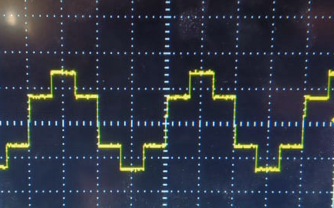
Hardware Testing
Results after Snubber
Inverter circuit output line voltage with Inductive
load with Snubber Circuit
[R = 35Ω, L = 1.5 mH].
23
23
23
23
23

Slide 24
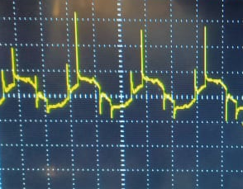
Hardware Testing
Testing Inverter with Motor
24
24
24
24
24

Slide 25
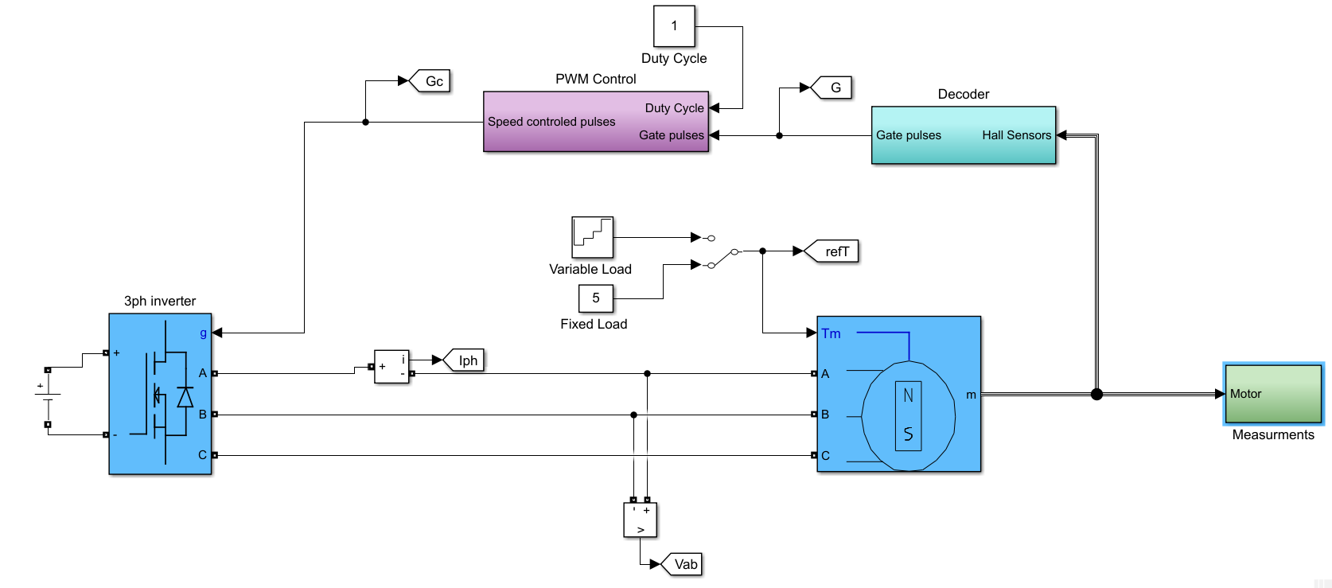
Open loop model
In this MATLAB model we try to simulate motor performance at several operating conditions
We will go through into each block to explain it

Slide 26
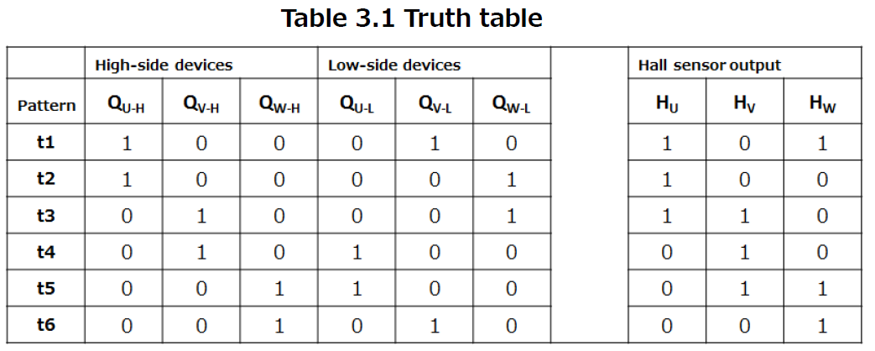
Six step commutation​
Hall sensors is used to detect the rotor position in order to commutate the correct phases to keep rotor spinning based on this lookup table

Slide 27
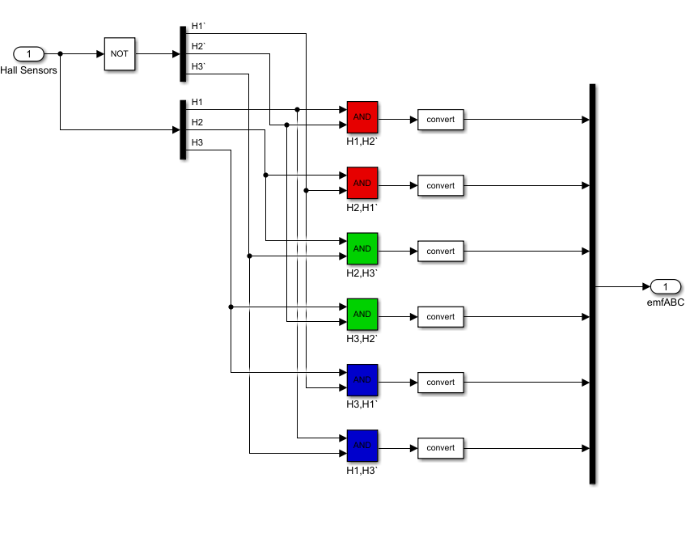
We implemented this logic in MATLAB simulink environment ​
0
1
0
1
1
1
0
1
1
1
1
1

Slide 28
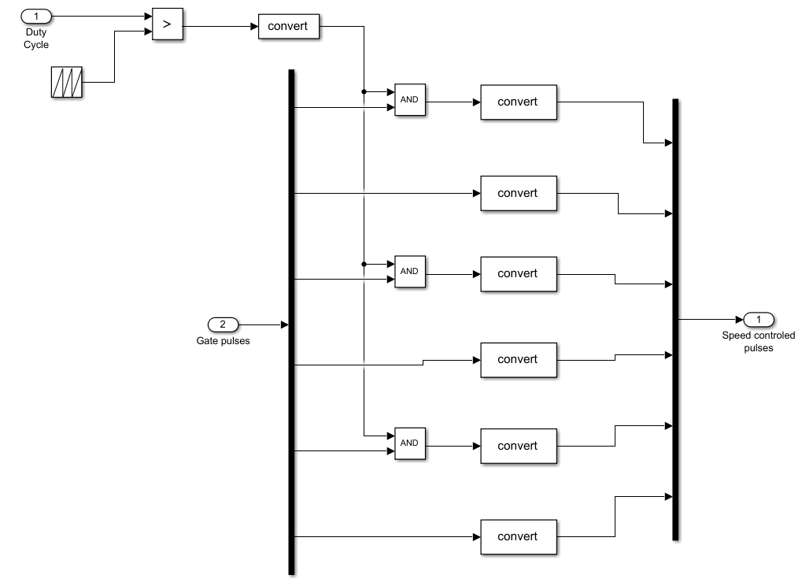
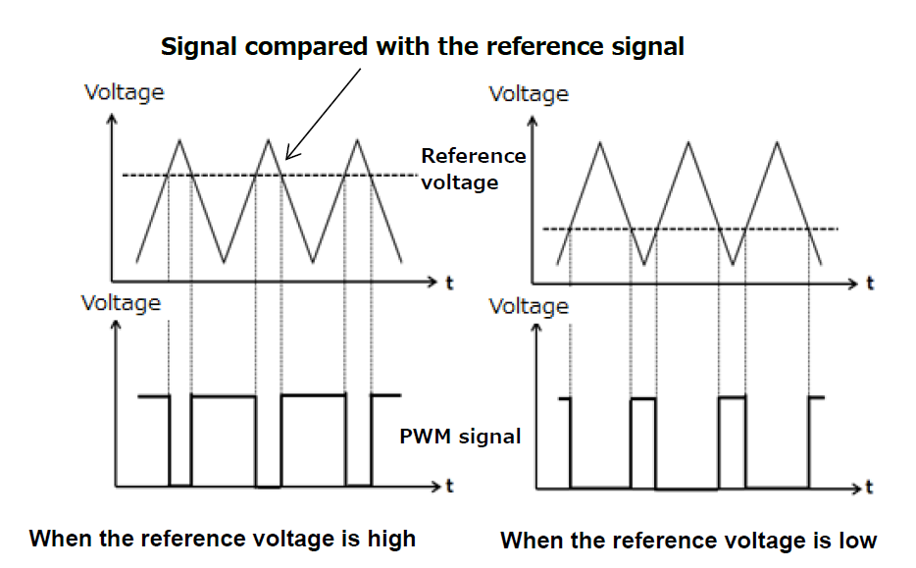
Open loop Speed control
We can use gate pulses generated based on six step commutation to control the speed of the motor by applying any PWM techniques
In our model we use method based on triangular wave form compared with reference voltage

Slide 29
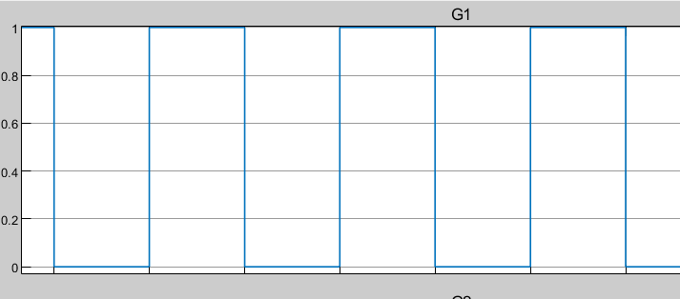
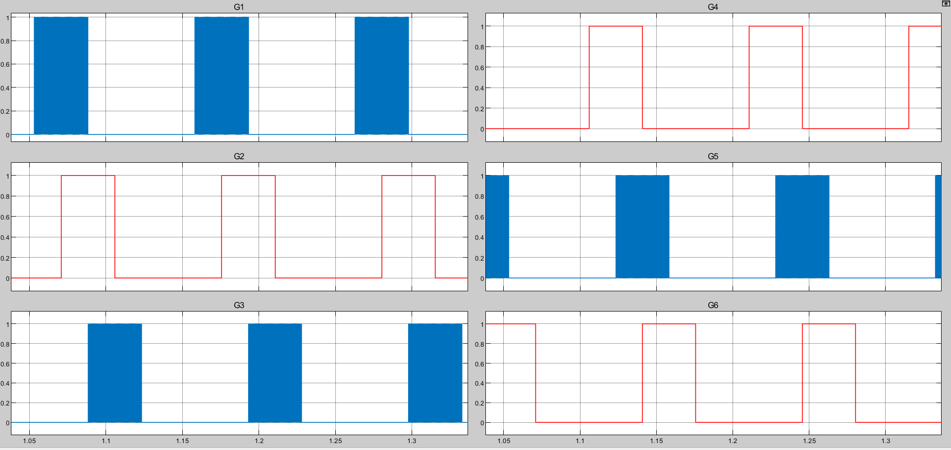
In our model we used non complementary switching method which means that PWM can be applied on gate pulses of high side MOSFETS
Gate pulses with Duty cycle = 50%

Slide 30
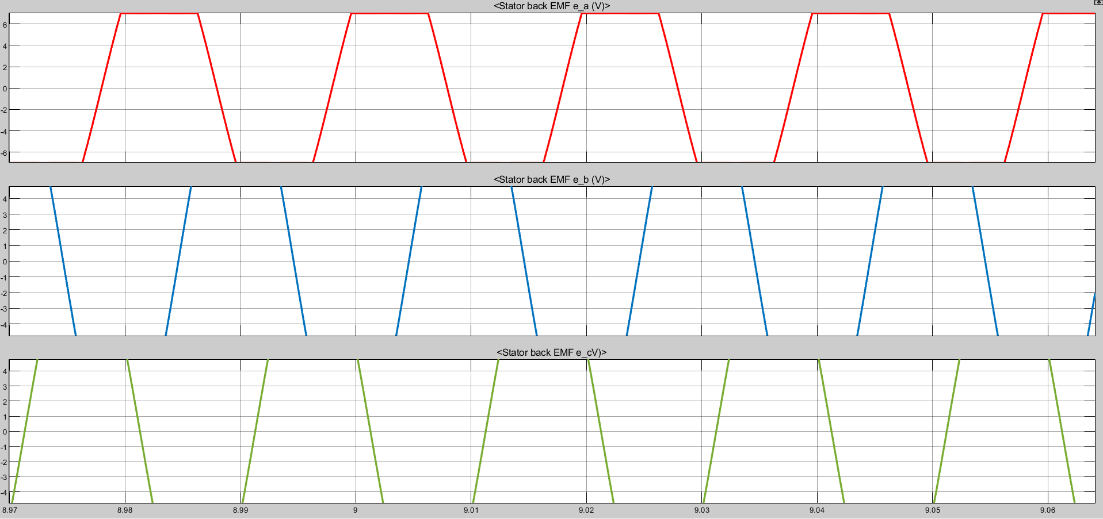
Back EMF wave form

Slide 31
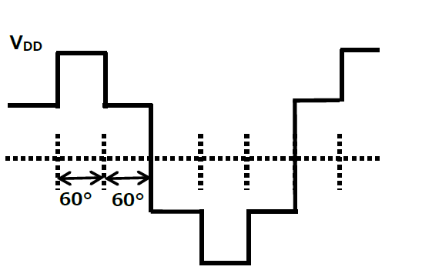
Inverter output voltage
Expected line voltage

Slide 32
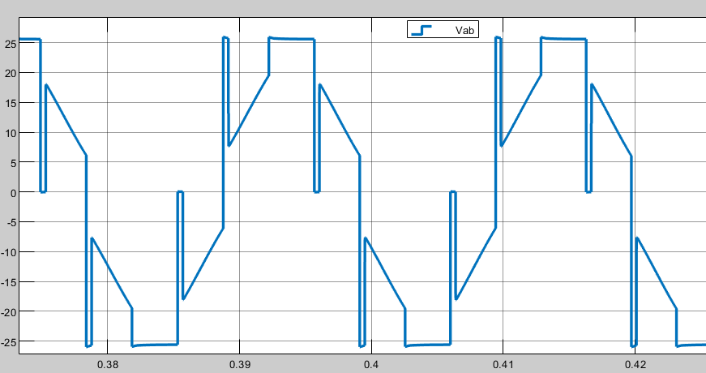
Inverter output voltage
Line voltage
VDC
Back EMF
Diode Freewheeling

Slide 33
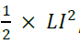
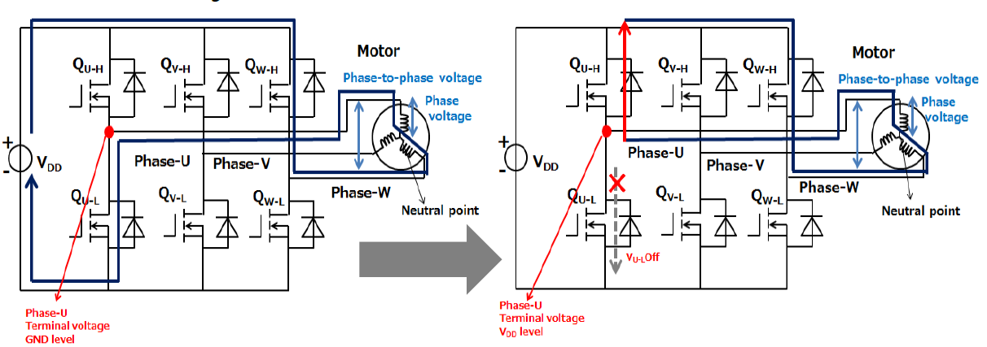
Diode freewheeling
During the commutation , each switch becomes off after 120 electrical degrees a current flowback through the body diode in switch until the energy stored in phase winding disappears , after that the terminal voltage becomes equal to the back-EMF voltage

Slide 34
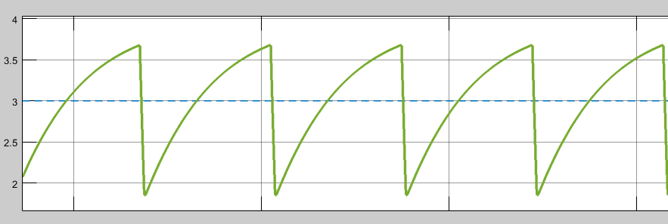
Torque ripples

Slide 35
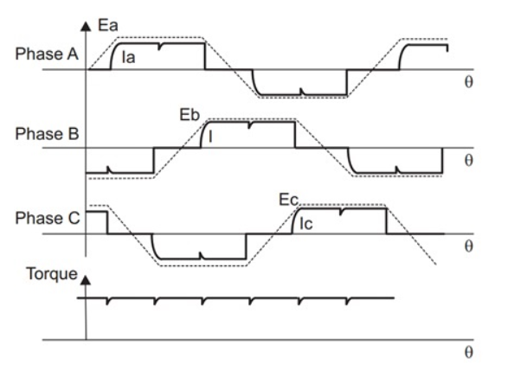
Torque ripples
The gross output torque from BLDC motors is the sum of beneficial electromagnetic torque (steady torque) and unwanted torque or torque ripple produced by :
Commutation
DC bus ripple
Commutation /electromagnetic torque ripple in BLDC motors
If we assume an ideal square-current waveform applied to the winding, the torque generated will be constant without any ripple
In reality , winding currents cannot rise or fall instantaneously because of the winding inductance.
This causes torque ripple during the commutation of BLDC motor phase currents as shown in Figure 1
Figure 1

Slide 36
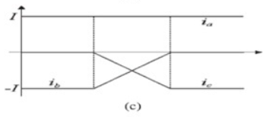
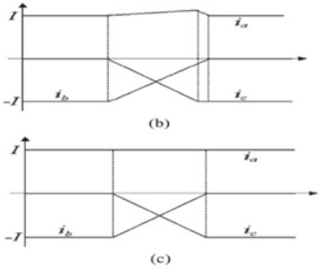
The following figures show three different cases depending on the current’s rising and falling rate of the commutating windings
Case A : the current increase and decrease rates of the two windings are the same as shown in Figure
Case B : there is a mismatch in the current’s rising and falling rate of the commutating windings, which in turn causes commutation torque ripple

Slide 37
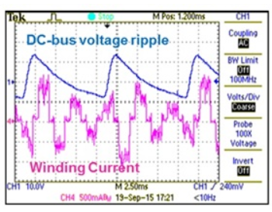
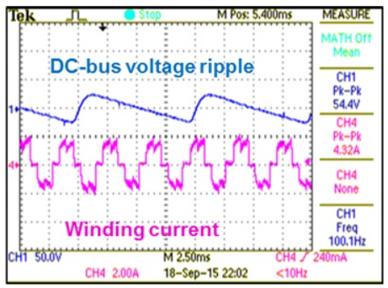
Torque ripple due to DC-bus voltage ripple
Bulk electrolytic capacitors are used on the high-voltage DC bus link of a mains-operated BLDC
The value of the capacitor for a given load decides the magnitude of ripple on the DC bus
A simple way to minimize torque ripple caused by DC-bus voltage ripple is to use a very-high-value DC bus capacitor this will increase overall size and system cost, as high-voltage capacitors are bulkier and take up a significant share of the bill of materials cost. A general thumb rule is to calculate the DC bus capacitor value to maintain DC-bus voltage ripple within 5-10%, depending on the quality of performance required.
With DC bus compensation
Without DC bus compensation

Slide 38

Motor performance

Slide 39

Phase current

Slide 40
Open loop full duty
Open loop variable duty

Slide 41

speed control of the BLDC motor

Slide 42

Speed calculation
The six steps represents 360º electrical of the motor rotation
The number of motor pole pairs → p = 20
The six steps represents $\frac{360}{20}$= 18º mech.
The rotor will rotate $\frac{\text{18}\text{o} \text{mech}\text{.}}{6}$ = 3º mech. per sector (step).
The motor speed = $\frac{3° ∗ \frac{π}{180 } }{Time between two steps }∗\frac{60}{2π }$ = $\frac{0.5 }{Time between two steps}$ (rpm)
The time between two steps is obtained by XOR the three hall sensors signals then measuring the time between two changes using input capture unit in the micro controller.

Slide 43


$Time between two steps$= $\frac{0.5 }{150 rpm}$ = 3.33msec

Slide 44
The implementation of speed measurement code

Slide 45

PI speed controller and limiter
PI speed control of the BLDC motor
The speed of the motor is compared with its reference value and the speed error is processed in proportional- integral (PI) speed controller.
The output of this controller is considered as the reference torque.
e(t) = ω_{ref} − ω_{m}
$$T_{ref}\left(n\right)=T_{ref}\left(n−1 \right){+ K}_{p}\left(e\left(n\right)−e\left(n−1\right)\right)+ K_{i} ∗\frac{T}{2} ∗\left(e\left(n\right)+e\left(n−1\right)\right)$$
Where
$K_{p}$ and, $K_{i}$ are the gains of PI speed controller.
T is the sampling time.

Slide 46



How to determine $K_{P} \&K_{i}$ ?
Transfer function model
Mathematical model for BLDC motor
2
2
At any sector
$$V_{DC}$$
2
Vs

Slide 47






Assume $T_{L}=0, b=0$
$$G\left(S\right)=\frac{ω(S)}{V_{d}(S)}=\frac{\frac{1}{k_{e}}}{τ_{m}τ_{e}S^{2}+τ_{m}S+1}$$
Transfer function
$$G\left(S\right)=\frac{1.587}{252×{10}^{−6} S^{2}+0.252S+1}$$
Poles = -1000 , -3.97
To simplify, we can neglect the pole at -1000. So it will become a first order system
$$ω_{M}=3.97≈4 rad/s$$
$$G_{M}\left(S\right)=\frac{1.587}{0.252S+1}$$
$$f_{M}=0.63 Hz$$

Slide 48











??
$$ω_{ref}$$
$$ω_{err}$$
$$G_{c}(S)$$
$$D$$
Inverter
$$V_{DC}^{`}$$
$$G_{M}(S)$$
$$ω_{act}$$
+
$$−$$
$$G_{phy}(S)$$
$$f_{sw}=5 kHz →$$
It is valid to assume it as a DC gain
Inverter Gain
$$=V_{DC}=36$$

Slide 49







Controller Design Requirements
Make low-frequency gain very large
To minimize steady-state error
Step input, Type 0 system
$$→ e_{ss}≠0$$
Make cross-over frequency $f_{c}$ as high as possible
To maximize closed-loop bandwidth.
For the system to response to wider range of frequencies.
$$f_{sw}=5 kHz →$$
Choose $f_{c}$ way lower than $f_{sw}$ as we consider the inverter as a DC gain.
$$f_{phy}=0.63 Hz →$$
Choose $f_{c}$ way higher than $f_{phy}$ to maximize closed-loop bandwidth.
Choose $f_{c}=50 Hz$
Maintain large enough phase margin $φ_{m}$
Phase margin > 0 is required for stability.
Larger phase margin is required for well behaved closed-loop response.
Choose $φ_{m}≥90°$

Slide 50













Proportional (P) Compensator
Proportional Integral (PI) Compensator
$$G_{c}\left(S\right)=G_{cm}$$
$$G_{c}\left(S\right)=G_{cm}\left(1+\frac{ω_{z}}{S}\right)$$
$$G_{cm}=1.4$$
$$G_{cm}=1.4$$
$$ω_{z}=ω_{phy}=4 rad/s$$
$$\left\|T(s)\right\|=38 dB$$
$$\left\|T(s)\right\|$$
Is high at low frequency
$φ_{m}=90°$
$φ_{m}=90°$
$$f_{c}$$
$$=50 Hz$$
$$f_{c}$$
$$=50 Hz$$

Slide 51









Step Reference $=150 rpm$
Step Response of (P)
Step Response of (PI)
Steady State Value $=148$
Steady State Value $=150$
Steady State Error $e_{ss}$ $=1.3\%$
Steady State Error $e_{ss}$ $=0\%$
Settling time $T_{s}$ $=16 msec$
Settling time $T_{s}$ $=13 msec$

Slide 52

Testing on Simulink Motor Model

Slide 53







Speed performance
Step input (Reference) $=150 rpm$
At fixed load $T_{L}=1 N.m$
Solution:
Using PI controller with Anti-Windup
Windup problem
$$O.S.≅53\%$$
$$O.S.≅3.3\%$$
$T_{s}=3.5 sec$
$T_{s}=0.9 sec$

Slide 54

Current limiter
The magnitude of the three phase current ( $i_{ref }$) is determined by using the reference torque ( $T_{ref }$)
$i_{ref }= \frac{T_{ref}}{K_{t}}$
A limit is put on the speed controller output depending on permissible maximum winding currents.
From the E.Bike inverter nameplate:
Operating Power = 330Watt
Operating voltage = 36-48vDC
For 3-phase inverter (${120}^{o}$ conduction mode) → V_{rms(line)} = V_{dc} * $\frac{\sqrt{2}}{2}$ = 25.5 : 44 volt
$I_{rms}=\frac{P}{\sqrt{3} ∗V }= \frac{330}{\sqrt{3} ∗25.5 }=7 amp$ → $Iperm$= 10 amp

Slide 55



IV. Reference current generator
The reference currents for each phase $i_{a}^{∗} ,i_{b}^{∗}$ , $i_{c}^{∗}$ are function of the value of reference current magnitude $i_{ref }$and the rotor position.
Sector | Rotor position | Active switches | $$i_{a}^{∗}$$ | $$i_{b}^{∗}$$ | $$i_{c}^{∗}$$
1 | 0 - 60 | S1 , S6 | $$i_{ref }$$ | - $i_{ref }$ | 0
2 | 60 - 120 | S1 , S2 | $$i_{ref }$$ | 0 | - $i_{ref }$
3 | 120 - 180 | S3 , S2 | 0 | $$i_{ref }$$ | - $i_{ref }$
4 | 180 - 240 | S3 , S4 | - $i_{ref }$ | $$i_{ref }$$ | 0
5 | 240 - 300 | S5 , S4 | - $i_{ref }$ | 0 | $$i_{ref }$$
6 | 300 - 360 | S5 , S6 | 0 | - $i_{ref }$ | $$i_{ref }$$
Reference current w.r.t rotor positions look up table

Slide 56


Reference current generator in simulink

Slide 57


Back Emf ‘s and currents
Ia_ref formation

Slide 58







Current control
Approach_1 : Hysteresis current control (discrete (ON/OFF) mode)
Approach_2 : PI current control (continuous (analog) mode)
$$I_{ref}$$
$$I_{line}$$
$$I_{ref}$$
Empirical guide lines for tuning $K_{p}$ , $K_{i}$ :
$$K_{p}= \frac{L_{s} ∗ ω_{c}}{2 ∗V_{dc}}$$
$$K_{i}= ω_{c} ∗K_{p}$$
$$I_{line}$$

Slide 59


Slide 60


Slide 61

Comparison between Hysteresis & PI current control
 | Hysteresis current control | PI current control
Design | Easy, no $K_{p}\&K_{i}$ | Require calculations of $K_{p}\&K_{i}$
Control action | The controller produces a discontinuous ON/OFF signal | The controller emits an analog output signal, so it need PWM module.
Switching frequency | Undefined so, it is difficult to design a filter to suppress switching harmonics | $$f_{sw}=f_{carrier}$$ Easy to design a filter
Hysteresis control is preferable

Slide 62

Comparison of BLDC drives with and without Hysteresis Current Controller

Slide 63
speed control of the BLDC motor in simulink

Slide 64

Speed Performance at different load torques and at different reference speeds
At different load torques
The motor dynamic behavior is analyzed when different load torques is applied at time t = 2s for the same speed (150 rpm).
Curve | Load torque (N.m) | Speed fall%
C1 | 2 | 2.7
C2 | 3.5 | 6
C3 | 5 | 9.3
C1
C2
C3

Slide 65

Speed Performance at different load torques and at different reference speeds
At different reference speed
The motor dynamic behavior is analyzed when same load torque (1N.m) is applied.
C3
Curve | Speed (rpm) | Settling time (sec)
C1 | 50 | 0.75
C2 | 100 | 0.8
C3 | 150 | 0.9
C2
C1

Slide 66
Timeline
Testing - Documentation
Brainstorming
Research
Oct - Nov
Jan - May
Aug - Oct
Nov - Dec
June - July
Idea Pitching
Implementation
15

Slide 67
Draft

Slide 68













Assume $T_{L}=0, b=0$
$$G\left(S\right)=\frac{ω(S)}{V_{d}(S)}=\frac{\frac{1}{k_{e}}}{τ_{m}τ_{e}S^{2}+τ_{m}S+1}$$
Transfer function
$$2E×I=ω×T$$
$$τ_{m}=\frac{R_{a}J}{k_{e}k_{t}}$$
$$τ_{e}=\frac{L_{a}}{R_{a}}$$
$$\frac{E}{ω}=\frac{T}{2I}$$
$$L_{a}=2L$$
$L$ is per-phase inductance
$$k_{e}=\frac{1}{2}k_{t}$$
$$R_{a}=2R$$
$R$ is per-phase resistance
$$k_{e}=2k_{e}^{`}$$
$k_{e}^{`}$ is L-L voltage constant
$$k_{t}=2k_{e}$$

Slide 69

Motor Parameters
Parameter | Value
Armature per-phase resistance, $R_{a}$ | $$0.25 Ω$$
Armature per-phase inductance, $L_{a}$ | $$250 µH$$
Back emf constant, $Ke$ (L-L) | $$0.315 V.s/rad$$
Torque constant, $K_{t}=2K_{e}$ | $$0.63 N.m/A$$
Viscous friction coefficient, $B$ | $$0$$
Rotor moment of inertia, $J$ | Rotor radius : $9 cm$ Wheel radius: $33 cm$ Motor weight: $3 Kg$ Wheel weight: $2 Kg$ $$Jtot = Jmotor + Jwheel + Jspokes$$ $$= 0.5 ∗ 3 ∗0.332 + 2 ∗ 0.092 ≅ 0.2 kg.m2$$
No. of poles, $2P$ | $$40$$
No. of phases, $m$ | $$3$$
Rated DC voltage $V_{DC}$ | $$36 V$$
Rated power, $P_{r}$ | $$330 W$$

Slide 70







$$ω$$
$$ω$$
Assume Load Torque $T_{L}=0 , b=0$
$$V_{d}\left(S\right)=R_{a}.I\left(S\right)+L_{a}.S.I\left(S\right)+K_{e}.ω(S)$$
$$K_{t}.I\left(S\right)=J.S.ω(S)$$
$$ω$$

Slide 71



$$V_{d}\left(S\right)=R_{a}.I\left(S\right)+L_{a}.S.I\left(S\right)+K_{e}.ω(S)$$
$$K_{t}.I\left(S\right)=J.S.ω(S)$$
$$G_{M}(S)$$

Slide 72





Inner loop
outer loop
Controller Design Requirements
Frequency of inner and outer loop should be away from $f_{sw}$ of inverter.
Inner loop should response faster than outer loop.
$$f_{sw}=5 kHz$$
$$f_{in−loop}=500 Hz$$
$$f_{out−loop}=50 Hz$$

Slide 73



$$ω_{phy2}$$
$$=4 rad/s$$
$$ω_{phy1}$$
$$=1000 rad/s$$

Slide 74








Current PI controller
$$G_{c1}\left(S\right)=G_{cm1}\left(1+\frac{ω_{z1}}{S}\right)$$
For $φ_{m}=90°$
$$ω_{z1}=ω_{phy1}=1000 rad/s$$
$$f_{z1}=160 Hz$$
By adding an integrator (pole at origin), and a real zero at -1000
$$G_{cm1}=0.044$$
$φ_{m}=90°$
$$f_{c}$$
$$=500 Hz$$

Slide 75






Speed PI controller
$$G_{c2}\left(S\right)=G_{cm2}\left(1+\frac{ω_{z2}}{S}\right)$$
For $φ_{m}=90°$
By adding an integrator (pole at origin), and a real zero at -6.38
$$ω_{z2}=6.38 rad/s$$
$$f_{z2}=1 Hz$$
$$G_{cm2}=63.2$$
$φ_{m}=83.2°$

